Slide 1
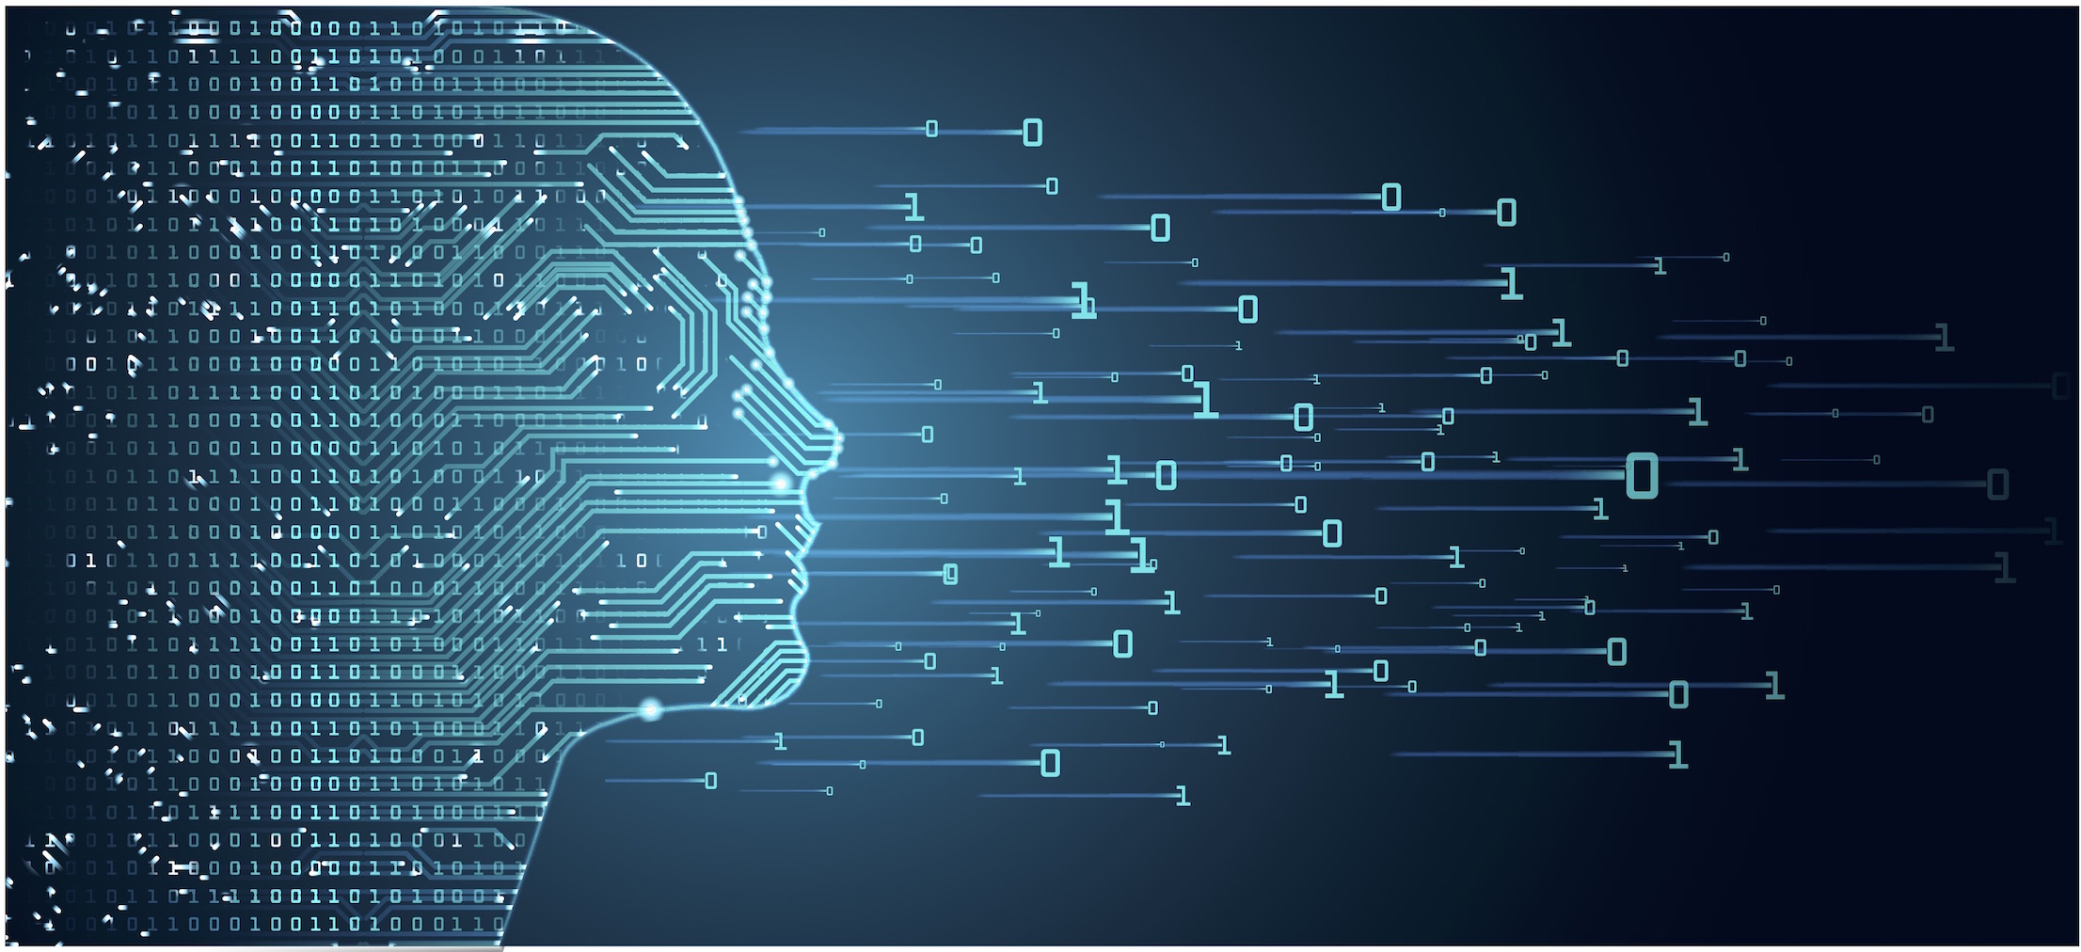
6372 Unit 2 Home Work
By-Rashmi Patel

